Slide 1
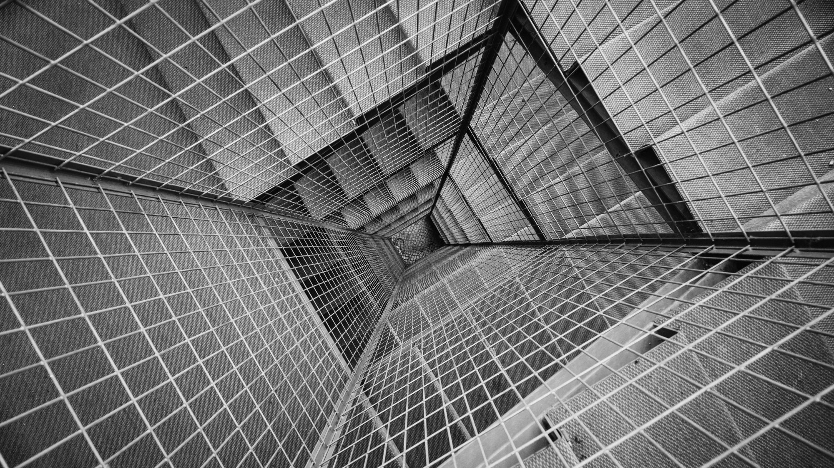
TECHJARS pec chandigarh
REAL TIME FACE RECOGNITION MODEL
JAGSEER
ANANT
RAHUL
SUHEL

Slide 2

ABOUT THE USECASE
About 175 individuals go missing everyday, out of which only 50% are recovered and most of the remaining are forced to beg . Everyday we hear about hundreds of crime happening in our society which are never solved. Sometimes Police have suspicion on someone but they don’t have the required technology to trace them down. This software will be a solution to all these crimes

Slide 3
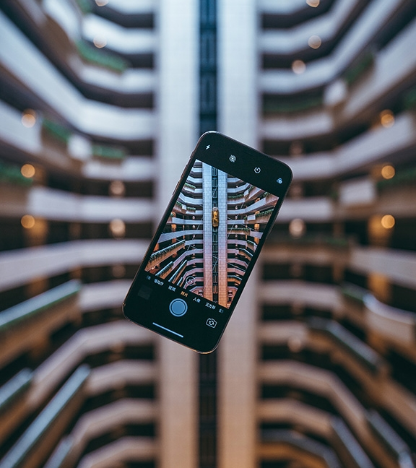
WHAT’S THE SOLUTION?
WE HAVE PROPOSED A SOLUTION USING COMPUTER VISION, DEEP LEARNING TO AUTOMATE THE TASK OF DETECTING AND LOCATING THE PERSON TO BE LOCATED

Slide 4
HOW THIS SOLUTION WORKS?
Each CCTV will have a unique camera ID.
Each officer will be provided access to the portal with unique ID, Password.
This portal will allow the authority to add photo of the person to be located to the database.
Each CCTV acts as a client and sends image frames to the server.
At the server the faces are detected from the images received using OpenCV and MTCNN.

Slide 5
HOW THIS SOLUTION WORKS?
Multiple clients(CCTVS) are handled using Multithreading technology.
The faces detected in live-feed are matched with the images present in the database.
If the image is matched then a notification is sent to the police client portal, with the timestamp and cam-ID.
For security reasons session time has been set to 10 Mins.

Slide 6
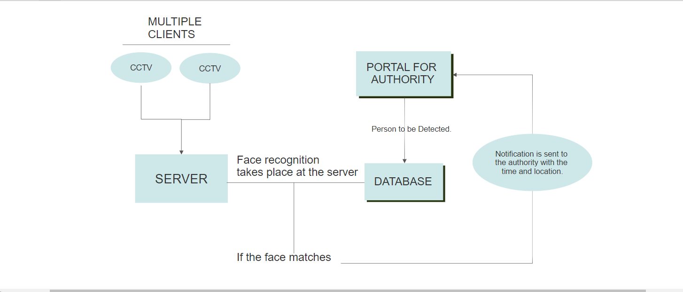
workflow of the model

Slide 7
Technology stack
HTML,CSS,BOOTSTRAP,JAVASERVER PAGES
JAVA(EE)
SOCKET PROGRAMMING(PYTHON) + THREADING
OPENCV+MTCNN
FACE DETECTION USING KERAS_VGGFACE LIBRARY BY REFIK CAN MALLI
OTHER TECHNOLOGIES USED:
MATPLOTLIB,PILLOW(PIL),NUMPY,SCIPY,PYODBC,TENSORFLOW,KERAS.

Slide 8
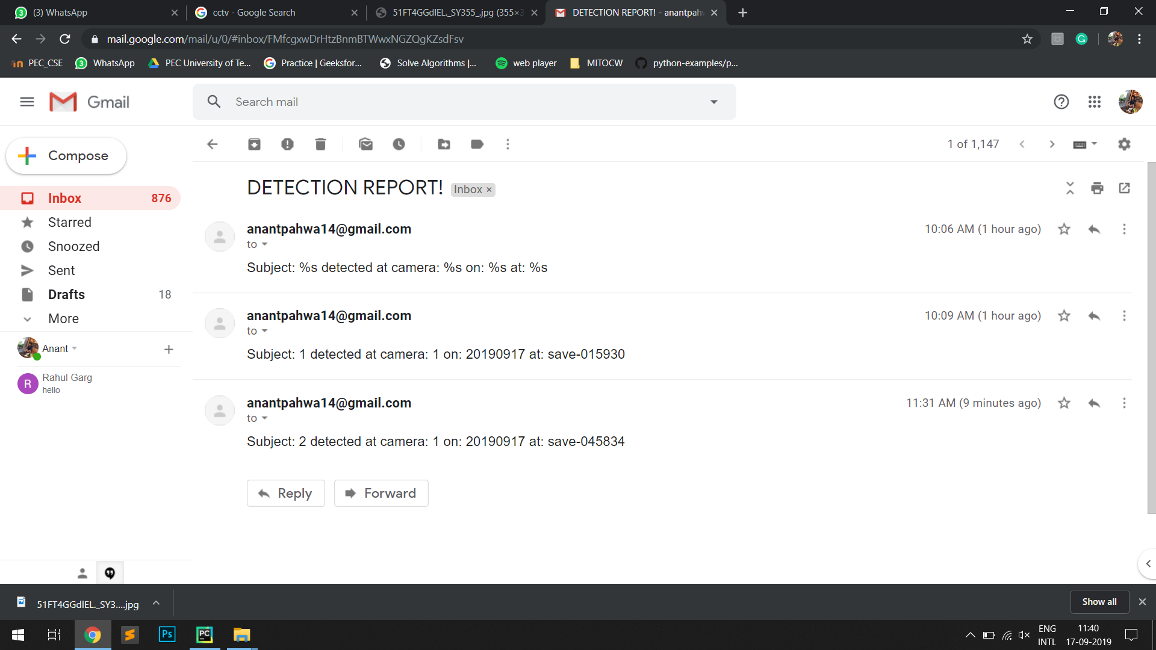
Email functionality

Slide 9
THANK YOU

